Slide 1
Project #98: Generating code through voice commands
Fraser McIntosh and Max Griffith

Slide 2
Seminar Overview
Project Definition
Motivation
Existing Solutions
Our Solution
The Application
Project Development
Application Design
User Study
Evaluation
Next Steps

Slide 3
Project Definition

Slide 4
Motivation

Slide 5
Motivation
The Computer
Omnipresent
Powerful and Versatile
Incapable users are disadvantaged

Slide 6
Motivation
Mouse and Keyboard
Imagine using a computer without them!

Slide 7
Motivation
The Software Developer
Computer-oriented occupation
Livelihood dependent on code ability
Heavy Mouse and Keyboard use
Repetitive Strain Injuries (RSI)

Slide 8
Motivation
Repetitive Strain Injuries (RSIs)
Pain and discomfort
From repeated, strenuous activity
Carpal Tunnel, Lateral Epicondylitis, Tendonitis
4-6 hours a day on mouse and keyboard greatly increases RSI risk¹
[1] B. M. Blatter and P. M. Bongers, "Duration of computer use and mouse use in relation to musculoskeletal disorders of neck or upper limb," International Journal of Industrial Ergonomics, vol. 30, (4), pp. 295-306, 2002.

Slide 9
Motivation
How to reduce RSI risk?
Limit reliance on physical interaction
Reduce dependence on mouse and keyboard

Slide 10
Motivation
Computer
Mouse & Keyboard
Software Developers
RSIs
Proposed Solution

Slide 11
Proposed Solution
A Hands-Free Alternative
A code environment, navigated entirely by voice
Focus on:
Limiting dependence on physical peripherals
Programming with natural and intuitive commands

Slide 12
Existing Solutions

Slide 13
Existing Solutions - Hands-Free Interfaces
Eye Gaze & Brain Computing Interface
Eye tracking acts as mouse cursor
Brain signals act as mouse clicks
Intuitive and accurate

Slide 14
Existing Solutions - Hands-Free Interfaces
Hand Gestures
Gestures similar to touch-based interface
Swiping and pointing

Slide 15
Existing Solutions - Hands-Free Interfaces
Summary
Primitive information transfer
Still strenuous for RSI users
Not suitable to develop code

Slide 16
Existing Solutions - Voice-to-Code Tools
VoiceCode²
Control entire computer through voice
Motion tracker attached to hat acts as cursor
Unique, extensive language of commands
Saying “Dubz” double clicks, “chips” single click
[2] A. D 'esilets, D. C. Fox and S. Norton, "VoiceCode: An innovative speech interface for programming-by-voice," in CHI '06 Extended Abstracts on Human Factors in Computing Systems, 2006, Available: http://doi.acm.org.ezproxy.auckland.ac.nz/10.1145/1125 451.1125502. DOI: 10.1145/1125451.1125502.

Slide 17
Existing Solutions - Voice-to-Code Tools
VoiceGrip³
Recognised the steep learning curves among existing solutions
To simplify, users write code one letter at a time via the NATO phonetic alphabet
“Hospital Echo Lima Lima Oscar, etc, etc” for HelloWorld
[3] A. Desilets, "VoiceGrip: A Tool for Programming- by-Voice," Int. J. Speech Technol., vol. 4, (2), pp. 103-116, 2001. Available: https://doi- org.ezproxy.auckland.ac.nz/10.1023/A:1011323308477. DOI: 1011323308477.

Slide 18
Existing Solutions - Voice-to-Code Tools
Summary
Very complex, involving a steep learning curve
Comprehensive enough to fully operate a computer
Too simple and ineffective to be productive
However, minimal effort is needed to use it

Slide 19
Our Solution

Slide 20
Our Solution
Meet in the middle
Not as simple as counterpart hands-free interfaces
Need enough information to code
Not as complex as existing speech to code tools
Need reduced complexity for newcomers
Needs to provide enough functionality

Slide 21
Our Solution
Introducing Natural Language
Commands based on how we speak in day to day lives
No need to learn a dictionary of commands
Speak how you want and the tool understands

Slide 22
Our Solution
Focus on Web
No existing solution for web developers
Our solution caters to HTML, CSS and JavaScript
Prototype Goal: Ability to build a basic website

Slide 23
Application

Slide 24
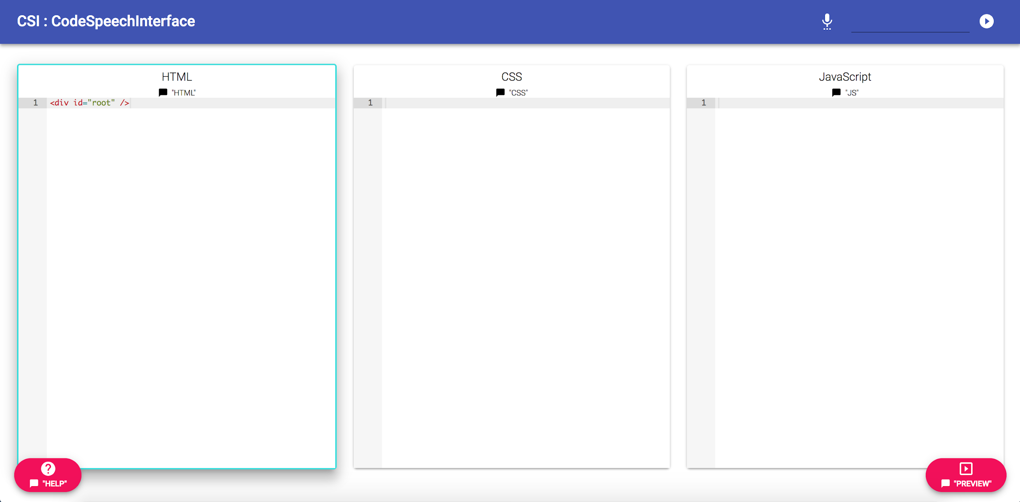
Application
Input displayed here
3 code editors
HTML in focus
Help button
Preview button
Notes:
3 code editors one for each language
Switch between them and code seamlessly
Completely navigable through voice

Slide 25

Demo
Application

Slide 26



Features
Application
HTML
CSS
JavaScript
Create element
Div, button, input elements supported
Set element id and class
Set element text
Delete element
Style by id, class or element type
Set text color
Set background color
Set width and height
Set margin
Create a function
Create click, mouse over, and other event listeners
Change text on event
Change style on event
Add or remove classes

Slide 27
“Switch to Fraser”

Slide 28
Project Development

Slide 29
Application Design

Slide 30






Application Design
Application
Speech
Speech Recognition
Intent
Action
Code

Slide 31
Application Design
Speech Recognition
Simple to use
Not our focus

Slide 32
Application Design
Solution - Web Speech API
Speech Recognition
Available in the Browser
Quick setup
Some limitations

Slide 33
Application Design
Intent
What is the user trying to do?
Different ways of saying the same command

Slide 34

Application Design
Solution -
Intent
Training Phrases - Machine Learning
Parameters

Slide 35
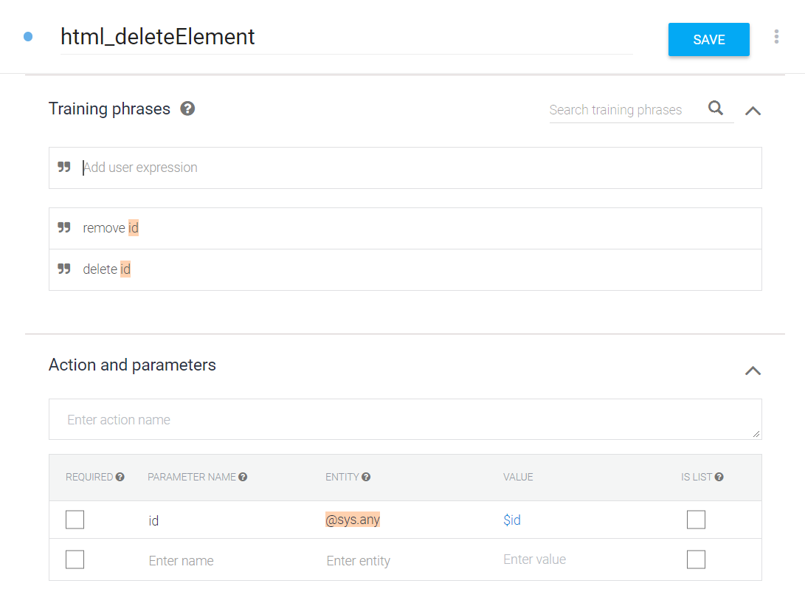
Dialogflow
Training Phrases
Parameters

Slide 36
Application Design
Action
Intents map to actions
Actions update code model

Slide 37
Application Design
Code
HTML, CS, JS data models
Actions change code
Code executes to generate website preview

Slide 38
Application Design
Problem
General recognition issues
Long sentences cause issues

Slide 39
Application Design
Context matters
“Exit” means different things depending on where you are!

Slide 40
Application Design
Solution
Short sentences
Infer meaning from context

Slide 41
Application Design
Problem
UI
Speech Interfaces unfamiliar
Possible user commands unclear

Slide 42
Application Design
Solution
UI
Helper Text
Second chances
Handle mistakes

Slide 43
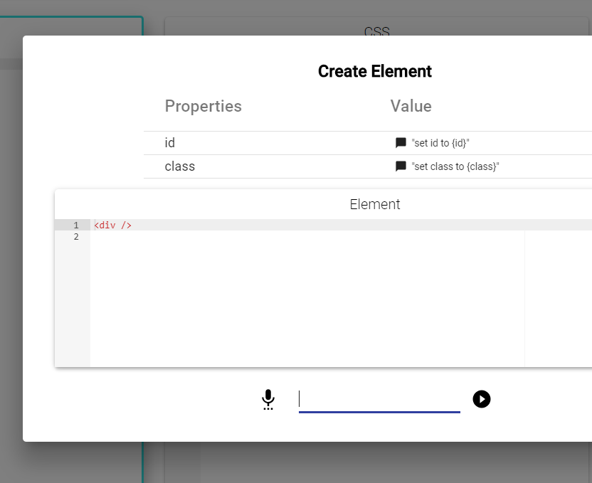
Application Design
Helper Text

Slide 44
User Study
Approved by Ethics Committee
Reference Number: 021146

Slide 45
User Study
Different command phrases
Speech interface expectations

Slide 46
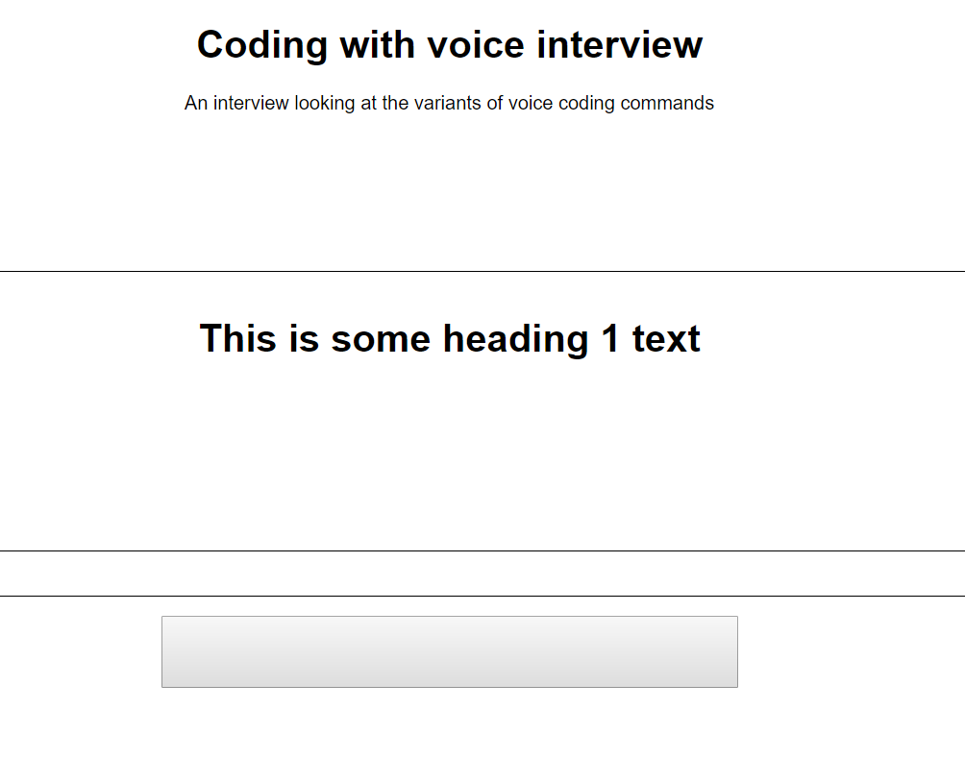

Slide 47
User Study
Create a button
"open button tag, close button tag"
vs
“create button”

Slide 48
User Study
"Speaking code is quite hard, you have to say it in the way that you couldn't accidentally be saying something else or be misinterpreted"

Slide 49
User Study
“I’d expect to just say one sentence as the command”
vs
“"I want it to be short and sharp”

Slide 50
User Study
Insights
Programmers think in code
Speaking code is difficult
Participants anticipate flaws in interface
Different expectations

Slide 51
Evaluation

Slide 52
Evaluation
What works well
Context minimises length of sentences
Sentences short, but natural
Command variations handled easily
Website preview gives fast feedback

Slide 53
Evaluation
What needs improvement
Speech recognition
Language features
Controlling speech recognition

Slide 54
Evaluation
Does it solve the problem?
Can create a website using voice commands!
Does not replace all functionality
Proof of concept

Slide 55
Next Steps

Slide 56
Next Steps
Custom language model
Support more language features
User Evaluation
Mobile App

Slide 57
Acknowledgements
Dr Kelly Blincoe - Primary Supervisor
Dr Catherine Watson - Secondary Supervisor

Slide 58
Thanks!
Question Time

